Slide 1
HTCondor Source Code: Organization and Building
Greg Thain

Slide 2
Source in github: htcondor/htcondor

Slide 3
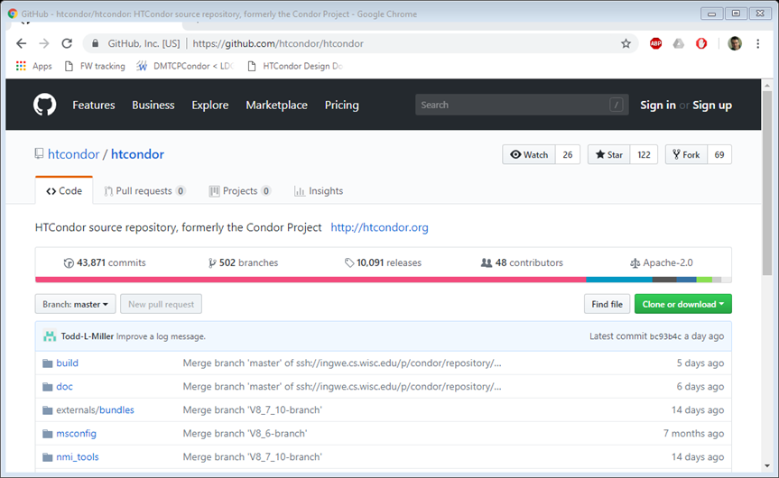

Slide 4
Condor wiki also good info
https://htcondor-wiki.cs.wisc.edu/index.cgi/wiki

Slide 5
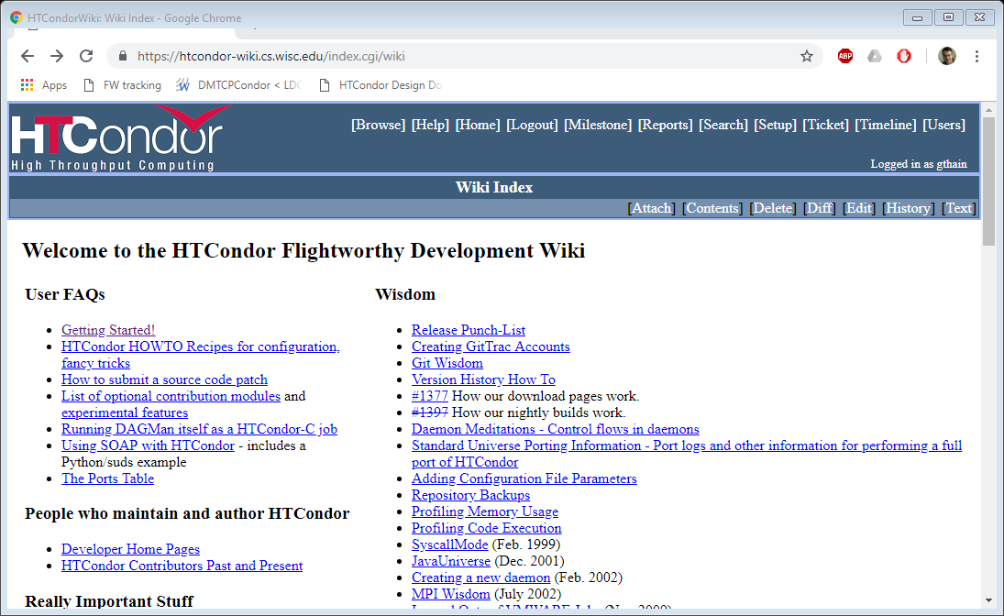
Click on
Getting Started

Slide 6
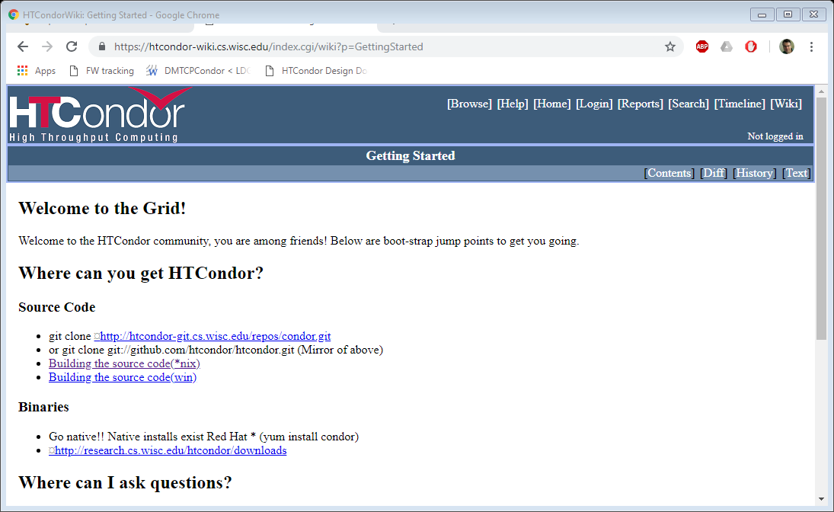
Click on
Building the source code (*nix)

Slide 7
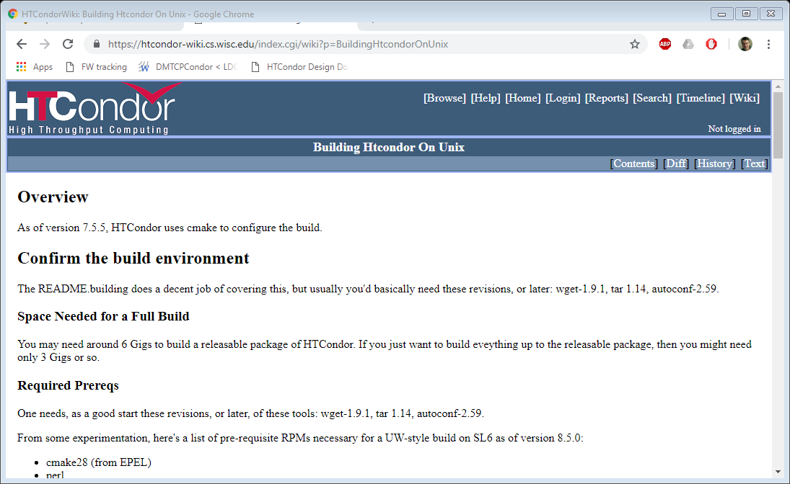

Slide 8
Check out with git commands
$ git clone https://github.com/htcondor/htcondor.git
$ *may take a while *

Slide 9
Then pick a branch
*master* is the default
Day-to-day commits go here, may be broken
Usually builds
VX_Y_Z-branch are release branches, stable e.g.
V8_7_10-branch
$ git checkout V8_7_10-branch

Slide 10
Brief overview of source tree
doc/: source for user manual
src/: all condor code
externals: all non-condor
CMakeLists.txt: main cmake file
build/: all cmake helpers

Slide 11
src directory has many subdirs
one for each executable: condor_schedd.V6, condor_master.V6….
One for common tools: condor_tools
One for libraries: condor_utils
ec2_gahp contains the ec2 gahp

Slide 12
Checkout a branch
$ git checkout V8_7_2-branch
Or
$ git checkout master
Maybe make a new branch for active development?
$ git branch –b master V8_8-alicloud-branch

Slide 13
Yum install build package
Wiki has a list…
RHEL6: cmake is needed by condor-8.9.0-0.201810170057.el6.x86_64 /usr/bin/flex is needed by condor-8.9.0-0.201810170057.el6.x86_64 /usr/bin/byacc is needed by condor-8.9.0-0.201810170057.el6.x86_64 pcre-devel is needed by condor-8.9.0-0.201810170057.el6.x86_64 openssl-devel is needed by condor-8.9.0-0.201810170057.el6.x86_64 krb5-devel is needed by condor-8.9.0-0.201810170057.el6.x86_64 libvirt-devel is needed by condor-8.9.0-0.201810170057.el6.x86_64 bind-utils is needed by condor-8.9.0-0.201810170057.el6.x86_64 libX11-devel is needed by condor-8.9.0-0.201810170057.el6.x86_64 libXScrnSaver-devel is needed by condor-8.9.0-0.201810170057.el6.x86_64 /usr/include/curl/curl.h is needed by condor-8.9.0-0.201810170057.el6.x86_64 /usr/include/expat.h is needed by condor-8.9.0-0.201810170057.el6.x86_64 openldap-devel is needed by condor-8.9.0-0.201810170057.el6.x86_64 python-devel is needed by condor-8.9.0-0.201810170057.el6.x86_64 boost-devel is needed by condor-8.9.0-0.201810170057.el6.x86_64 sqlite-devel is needed by condor-8.9.0-0.201810170057.el6.x86_64 cmake >= 2.8 is needed by condor-8.9.0-0.201810170057.el6.x86_64 gcc-c++ is needed by condor-8.9.0-0.201810170057.el6.x86_64 glibc-static is needed by condor-8.9.0-0.201810170057.el6.x86_64 libuuid-devel is needed by condor-8.9.0-0.201810170057.el6.x86_64 bison-devel is needed by condor-8.9.0-0.201810170057.el6.x86_64 bison is needed by condor-8.9.0-0.201810170057.el6.x86_64 byacc is needed by condor-8.9.0-0.201810170057.el6.x86_64 flex is needed by condor-8.9.0-0.201810170057.el6.x86_64 libtool is needed by condor-8.9.0-0.201810170057.el6.x86_64 libtool-ltdl-devel is needed by condor-8.9.0-0.201810170057.el6.x86_64 pam-devel is needed by condor-8.9.0-0.201810170057.el6.x86_64 nss-devel is needed by condor-8.9.0-0.201810170057.el6.x86_64 libxml2-devel is needed by condor-8.9.0-0.201810170057.el6.x86_64 expat-devel is needed by condor-8.9.0-0.201810170057.el6.x86_64 perl-Archive-Tar is needed by condor-8.9.0-0.201810170057.el6.x86_64 perl-XML-Parser is needed by condor-8.9.0-0.201810170057.el6.x86_64 libcurl-devel is needed by condor-8.9.0-0.201810170057.el6.x86_64 libcgroup-devel >= 0.37 is needed by condor-8.9.0-0.201810170057.el6.x86_64 boost-python is needed by condor-8.9.0-0.201810170057.el6.x86_64 transfig is needed by condor-8.9.0-0.201810170057.el6.x86_64 latex2html is needed by condor-8.9.0-0.201810170057.el6.x86_64 RHEL7: cmake is needed by condor-8.9.0-0.201810170551.el7.x86_64 /usr/bin/flex is needed by condor-8.9.0-0.201810170551.el7.x86_64 /usr/bin/byacc is needed by condor-8.9.0-0.201810170551.el7.x86_64 pcre-devel is needed by condor-8.9.0-0.201810170551.el7.x86_64 openssl-devel is needed by condor-8.9.0-0.201810170551.el7.x86_64 krb5-devel is needed by condor-8.9.0-0.201810170551.el7.x86_64 libvirt-devel is needed by condor-8.9.0-0.201810170551.el7.x86_64 bind-utils is needed by condor-8.9.0-0.201810170551.el7.x86_64 m4 is needed by condor-8.9.0-0.201810170551.el7.x86_64 libX11-devel is needed by condor-8.9.0-0.201810170551.el7.x86_64 libXScrnSaver-devel is needed by condor-8.9.0-0.201810170551.el7.x86_64 /usr/include/curl/curl.h is needed by condor-8.9.0-0.201810170551.el7.x86_64 /usr/include/expat.h is needed by condor-8.9.0-0.201810170551.el7.x86_64 openldap-devel is needed by condor-8.9.0-0.201810170551.el7.x86_64 python-devel is needed by condor-8.9.0-0.201810170551.el7.x86_64 boost-devel is needed by condor-8.9.0-0.201810170551.el7.x86_64 sqlite-devel is needed by condor-8.9.0-0.201810170551.el7.x86_64 cmake >= 2.8 is needed by condor-8.9.0-0.201810170551.el7.x86_64 gcc-c++ is needed by condor-8.9.0-0.201810170551.el7.x86_64 glibc-static is needed by condor-8.9.0-0.201810170551.el7.x86_64 libuuid-devel is needed by condor-8.9.0-0.201810170551.el7.x86_64 bison-devel is needed by condor-8.9.0-0.201810170551.el7.x86_64 bison is needed by condor-8.9.0-0.201810170551.el7.x86_64 byacc is needed by condor-8.9.0-0.201810170551.el7.x86_64 flex is needed by condor-8.9.0-0.201810170551.el7.x86_64 libtool is needed by condor-8.9.0-0.201810170551.el7.x86_64 libtool-ltdl-devel is needed by condor-8.9.0-0.201810170551.el7.x86_64 pam-devel is needed by condor-8.9.0-0.201810170551.el7.x86_64 nss-devel is needed by condor-8.9.0-0.201810170551.el7.x86_64 libxml2-devel is needed by condor-8.9.0-0.201810170551.el7.x86_64 expat-devel is needed by condor-8.9.0-0.201810170551.el7.x86_64 perl-Archive-Tar is needed by condor-8.9.0-0.201810170551.el7.x86_64 perl-XML-Parser is needed by condor-8.9.0-0.201810170551.el7.x86_64 perl(Digest::MD5) is needed by condor-8.9.0-0.201810170551.el7.x86_64 libcurl-devel is needed by condor-8.9.0-0.201810170551.el7.x86_64 libcgroup-devel >= 0.37 is needed by condor-8.9.0-0.201810170551.el7.x86_64 boost-python is needed by condor-8.9.0-0.201810170551.el7.x86_64 systemd-devel is needed by condor-8.9.0-0.201810170551.el7.x86_64 transfig is needed by condor-8.9.0-0.201810170551.el7.x86_64 latex2html is needed by condor-8.9.0-0.201810170551.el7.x86_64

Slide 14
Configure and make
$ ./configure_uw
$ make
$ make install

Slide 15
Submit side for vanilla jobs
condor_master
(pid: 1740)
condor_procd
fork/exec
“Condor Kernel”
condor_schedd
condor_q
condor_submit
“Tools”
fork/exec
condor_shadow
condor_shadow
condor_shadow
“Condor Userspace”

Slide 16
Submit side for grid jobs
condor_master
(pid: 1740)
condor_procd
fork/exec
“Condor Kernel”
condor_schedd
condor_q
condor_submit
“Tools”
fork/exec
condor_gridmanager
Ec2_gahp

Slide 17
EC2_GAHP
Documented in
src/ec2_gahp/ec2_gahp_protocol.txt
1. INTRODUCTION
The object of the Grid ASCII Helper Protocol (GAHP) is to allow the
use of the client library or package of a grid or cloud service via
a simple ASCII-based protocol. A process which implements GAHP is
referred to as a GAHP server. GAHP is designed to handle both
synchronous (blocking) and asynchronous (non-blocking) calls.
The first GAHP specification focused on the GRAM and GASS grid
services of the Globus Toolkit. This GAHP specification focuses on
the Google Compute Engine (GCE) cloud service.
1.1 WHY A GAHP?
Although most grid and cloud services provide client libraries or

